Slide 1
LGBTQ+ Heroes
Created by AMU Human Rights Committee 2018

Slide 2
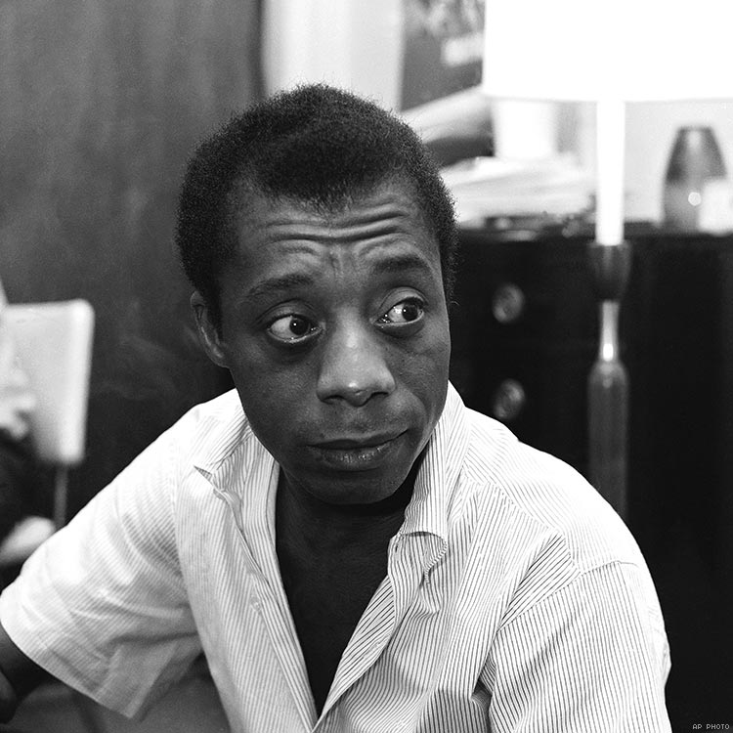
James Baldwin
NOVELIST & SOCIAL CRITIC
Baldwin’s many well-known writings explore race, sexual orientation, class, and more in 20th-century America. He won many awards for his novels and plays during his career.

Slide 3
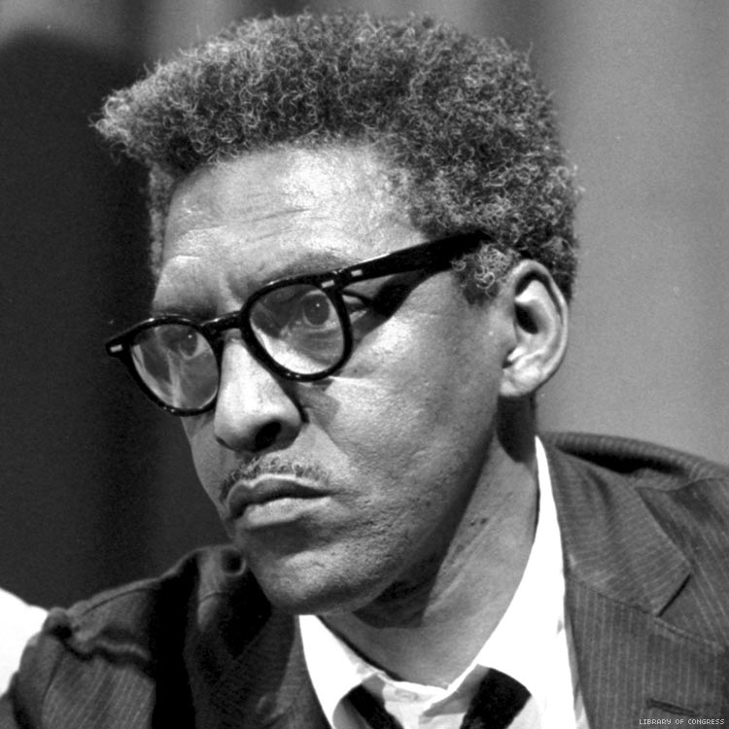
Bayard Rustin
CIVIL RIGHTS ACTIVIST
Rustin was a leading strategist of the Civil Rights Movement from 1955 to 1968. He worked with many other well-known leaders, including Dr. King and Stokely Carmichael, in organizations such as the Congress on Racial Equality and the Student Nonviolent Coordinating Committee.

Slide 4
Audre Lorde
WRITER, LIBRARIAN, CIVIL RIGHTS ACTIVIST
Lorde’s poems and writings often deal with civil rights, feminism, and the exploration of Black female identity. She was a professor at Lehman College, the John Jay College of Criminal Justice, and Hunter College.

Slide 5
Laverne Cox
ACTRESS & LGBTQ+ ADVOCATE
Cox was the first transgender person to be nominated for a Primetime Emmy Award in the acting category for her work on Orange is the New Black. She has broken many barriers and continues to advocate for transgender people of color.

Slide 6
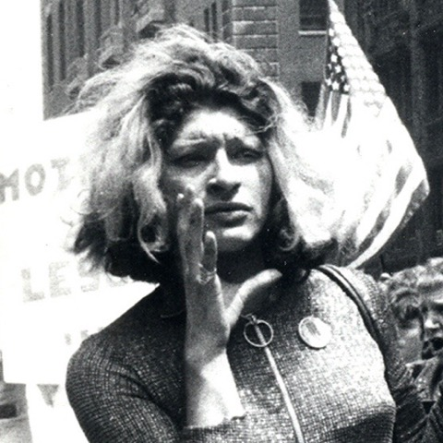
Sylvia Rivera
ACTIVIST & DRAG QUEEN
Rivera’s activism on behalf of gay and transgender communities has made a lasting impact. She was a co-founder of multiple organizations, including the Gay Liberation Front and the Gay Activists Alliance. She was critical during the Stonewall Riots in 1969.

Slide 7
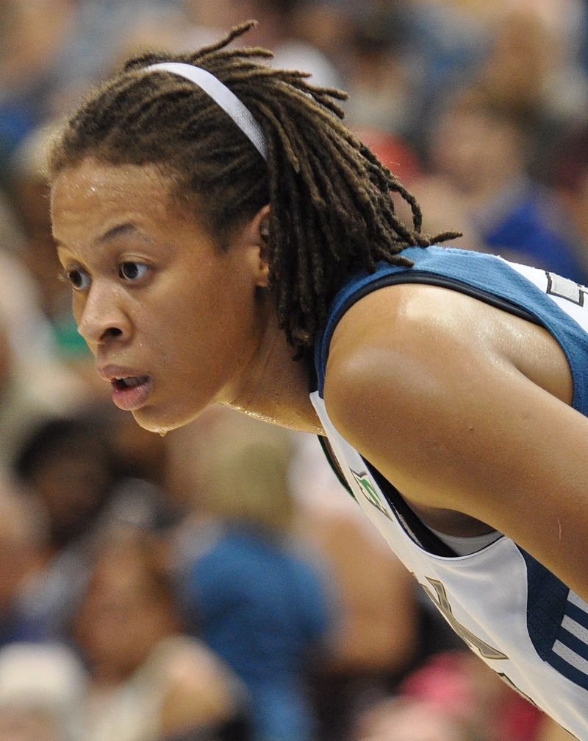
Seimone Augustus
PROFESSIONAL BASKETBALL PLAYER
Originally from Baton Rouge, Louisiana, Augustus has led the Minnesota Lynx to 4 WNBA championships and has earned gold medals at the 2008, 2012, and 2016 Summer Olympics.

Slide 8
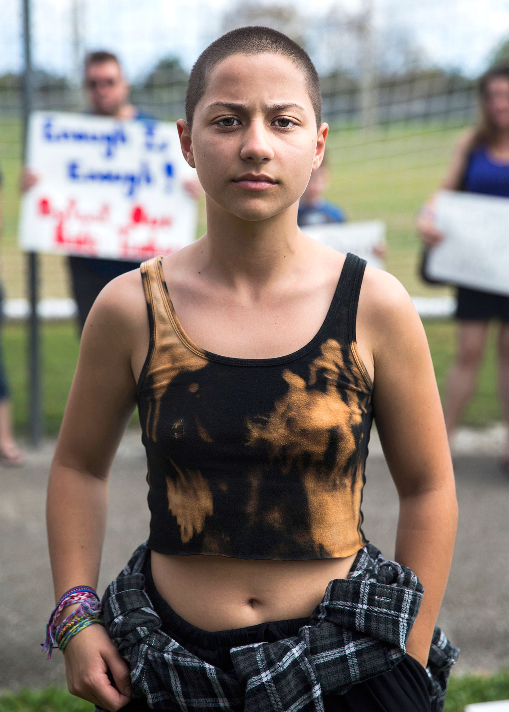
Emma Gonzalez
Activist
A survivor of the 2018 shooting at Marion Stoneman Douglass High School in Parkland, Florida, Gonzalez has become an outspoken activist for gun control and a leader of the March for Our Lives, the largest student protest in American history. Gonzalez is openly identifies as bisexual.

Slide 9
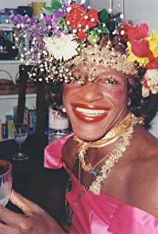
Marsha P. Johnson
Activist
Johnson was an African American activist and leader in the gay liberation movement that began with the Stonewall uprising in 1969. Later in life, Johnson continued to fight for LGBTQ issues as an AIDs activist.

Slide 10
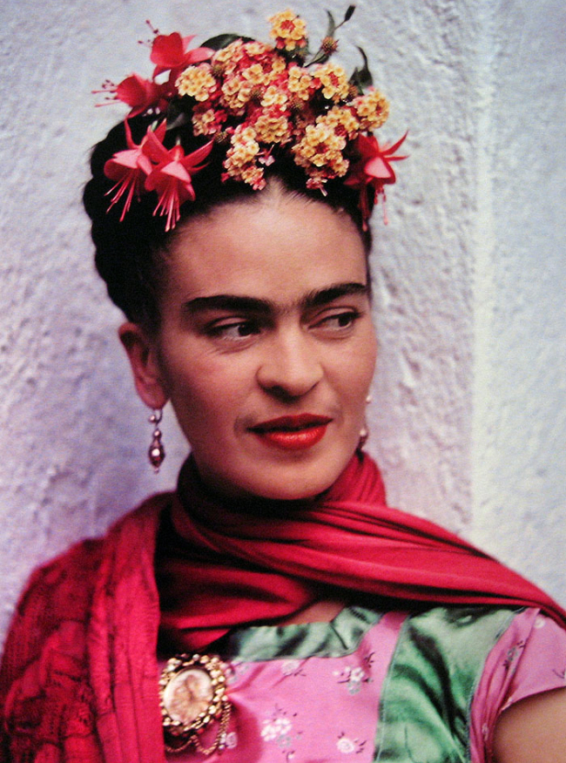
Frida Kahlo
Artist
Mexican artist whose work explored many different themes of identidy, gender, class, race.

Slide 11
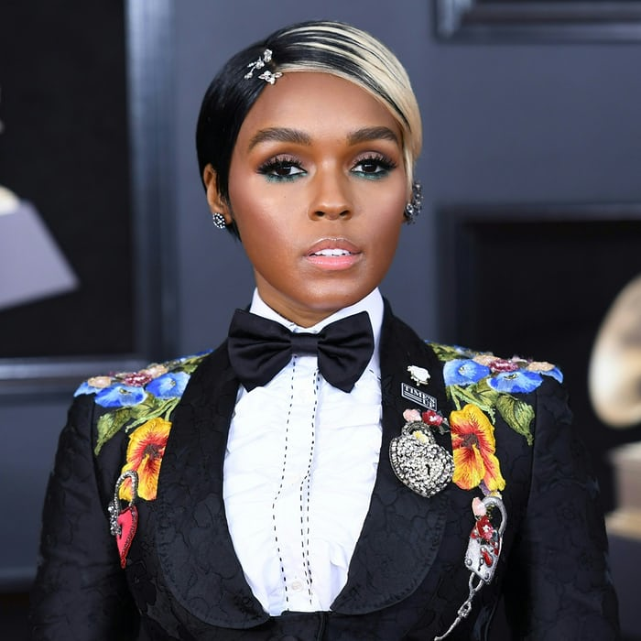
Janelle Monae
Singer, songwriter, producer, actress, and model. Monae has received major awards and nominations for her work in both music and film. In 2018 she stated that she identifies as both bisexual and pansexual.

Slide 12
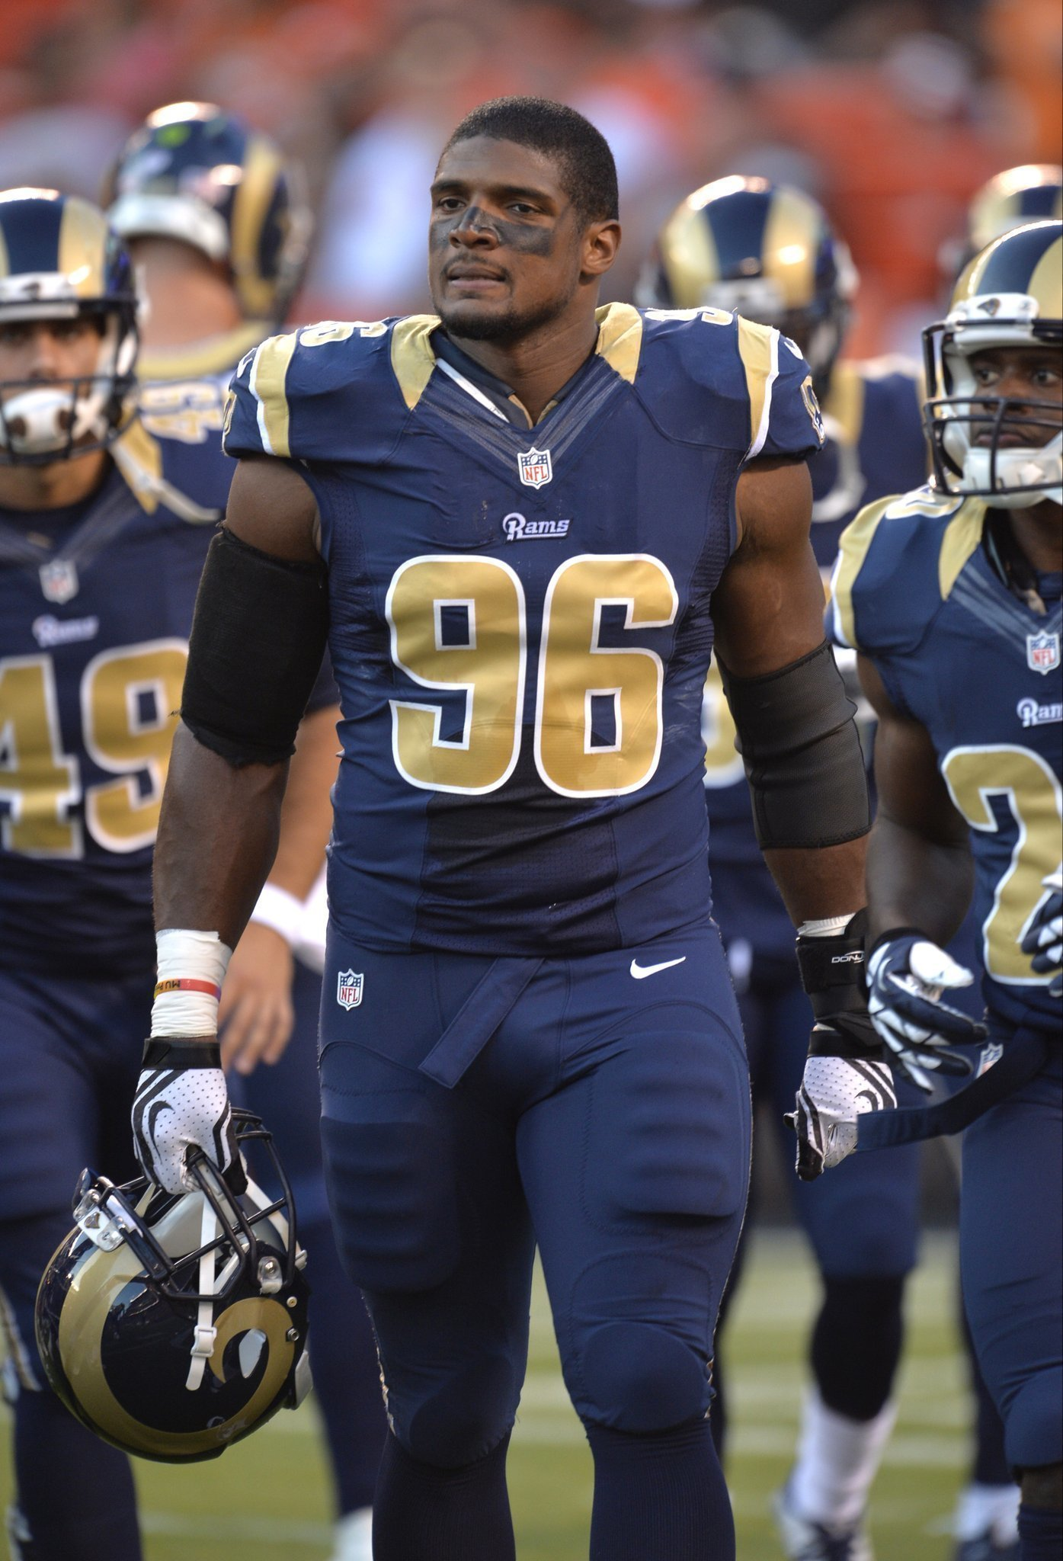
Michael Sam
NOVELIST & SOCIAL CRITIC
First openly gay football player to be drafted in the NFL. Sam is also a motivational speaker, and an advocate for LGBTQ rights.

Slide 13
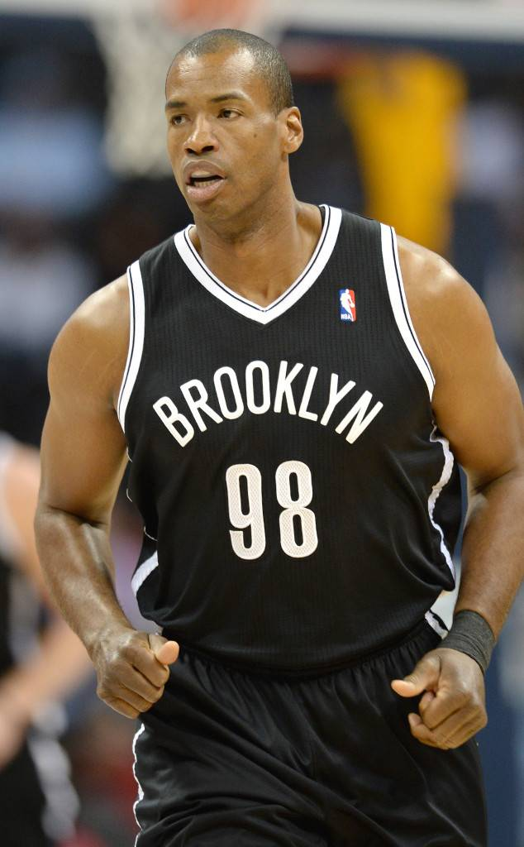
Jason Collins
NBA Player
Collins is a retired athlete who played 13 seasons in the NBA. He played college basketball for Stanford University where he was an All-American in 2000-01. A free agent in 2014, he signed with the New York Nets and became the first publicly gay athlete to plan in any of four major North American professional sports leages.

